Slide 1
Multiple blood feeding case studies

Slide 2
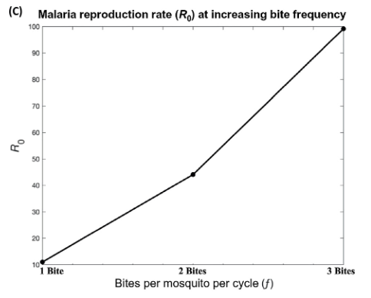
Multiple blood feeding may multiple transmission
More feeding attempts
3x increase in biting frequency
→ 10x increase in in transmission
More contact with hosts
More opportunities for disease transmission
Tedrow, R. E., P. A. Zimmerman, and K. C. Abbott. 2019. Multiple Blood Feeding: A Force Multiplier for Transmission. Trends in parasitology 35:949–952.

Slide 3
Drivers of multiple* blood feeding
Larval conditions
Less “healthy” adults may need multiple blood meals to obtain sufficient nutrients for egg formation and oviposition
Meal diversity
Feeding on a variety of blood meal sources may lead to higher fecundity
Interruption by defensive behavior
Defensive behaviors of animals can destroy mosquitoes
Some animals feed on mosquitoes
*some authors differentiate between “multiple” and “interrupted” blood feeding

Slide 4
Should multiple blood feeding behavior increase or decrease transmission potential?
Increase
Decrease
More contact events, more opportunities for transmission
(Potentially) allows for full cycle of transmission (host→vector→host) in a single gonotrophic cycle
Earlier opportunities for transmission (decrease in time between to and from transmission)
Shorter periods of contact, smaller probability of successful transmission
Multiple blood feeding is risky; decreases mosquito lifespan and infectious period

Slide 5
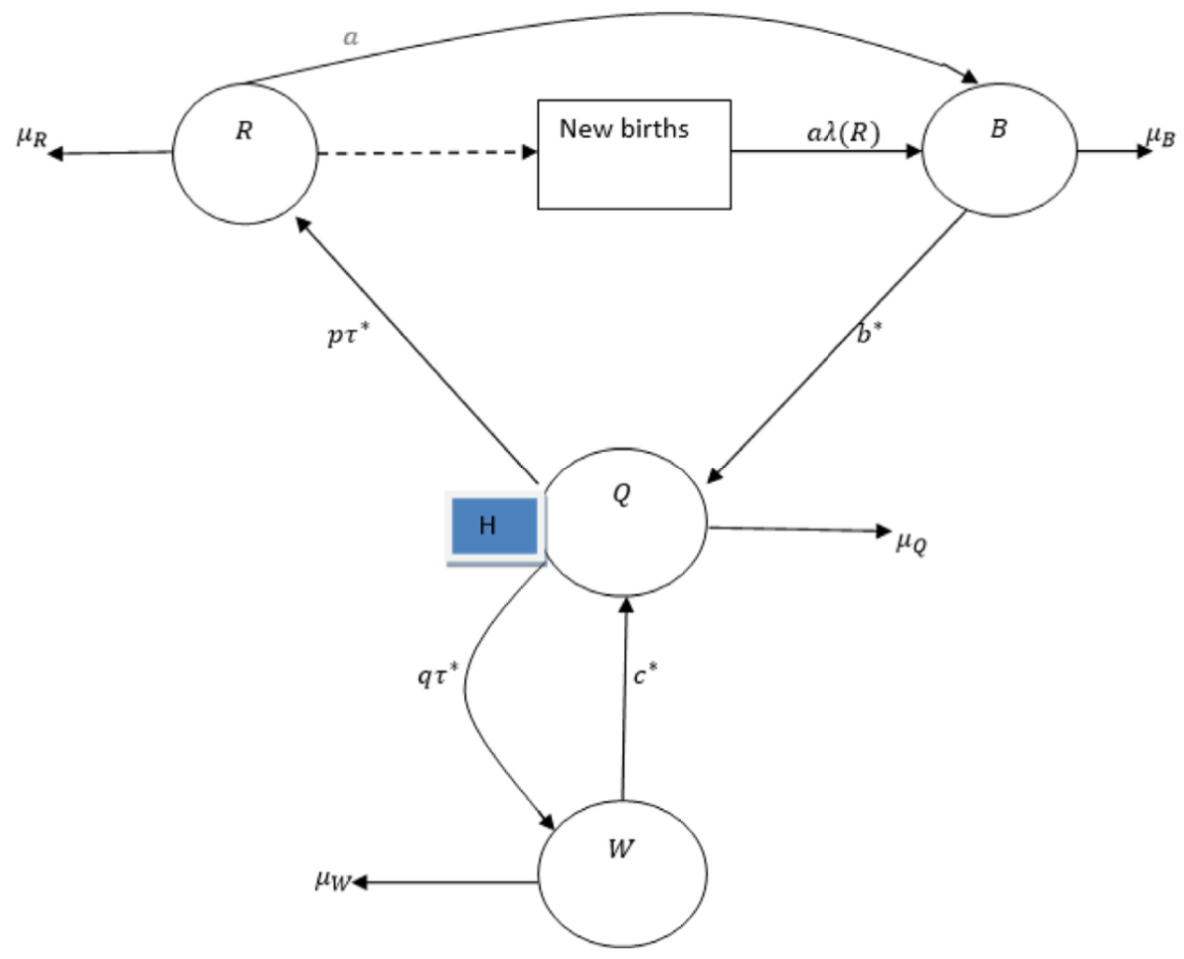
Past models of multiple blood feeding
Many authors have incorporated multiple blood feeding into models simply by multiplying the contact rate
Ghakanyuy et al. (2022) explicitly model the possibility of failed blood feeding leading to multiple feeds per gonotrophic cycle
Christofferson et al. (2022) developed an IBM of transmission in a 2-person household, allowing for multiple feeds by the the mosquito
Anderson and Roitberg (1999) developed a stochastic simulation model to evaluate relative dis/advantages of multiple blood in regard to mosquito fitness
Tedrow too
This list is by no means complete

Slide 6
Goal
Long-term:
We aim to develop a framework for incorporating multiple blood feeding processes into ODE models in manner that allows for the fitting of parameters to data
For now:
Develop simple models of types of multiple blood feeding processes (e.g. larval rearing conditions vs. interrupted feeding)
Determine how differences in multiple blood feeding processes might drive differences in how multiple blood feeding impacts transmission
Does the form of the process impact the purported increasing relationship between multiple feeding and transmission potential?

Slide 7
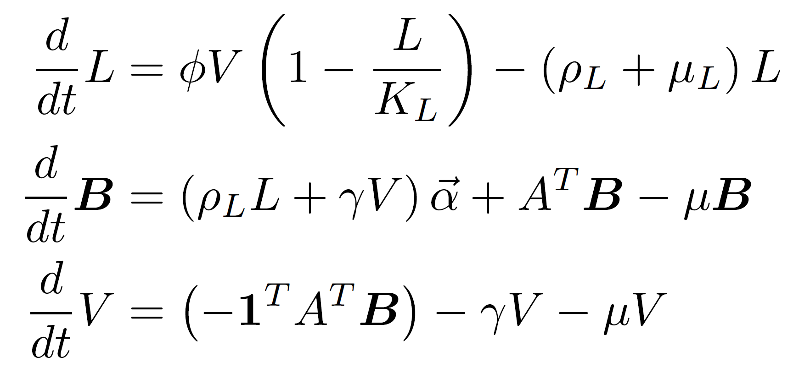
General form of the case study models
Larval recruitment
Larval or aquatic stages
Larval development
Transitions within blood-feeding stages
Blood-feeding stages
Oviposition stage
From blood-feeding to oviposition

Slide 8
Case study models
Fate model
Disrupt model
The number of blood meals needed for repletion is determined at birth
This number depends on the conditions in which the larval mosquito was reared
Worse conditions lead to the need for multiple blood meals
The number of blood meals needed for repletion depends on feeding success, which may be limited by host defensive behaviors
At each feeding attempt, mosquitoes have some probability of feeding to repletion or requiring another blood meal

Slide 9
“Disrupt” model
Aquatic stage
Blood-feeding
Blood-feeding
Blood-feeding
Blood-feeding
Ovipositing
At each blood-feeding stage, a mosquito has a possibility of reaching repletion or requiring additional blood meals
The waiting time to leave the blood-feeding stages is represented by a Coxian distribution
Notes:
Mixture of Coxian distributed waiting time and exponential (minimum of the two)

Slide 10


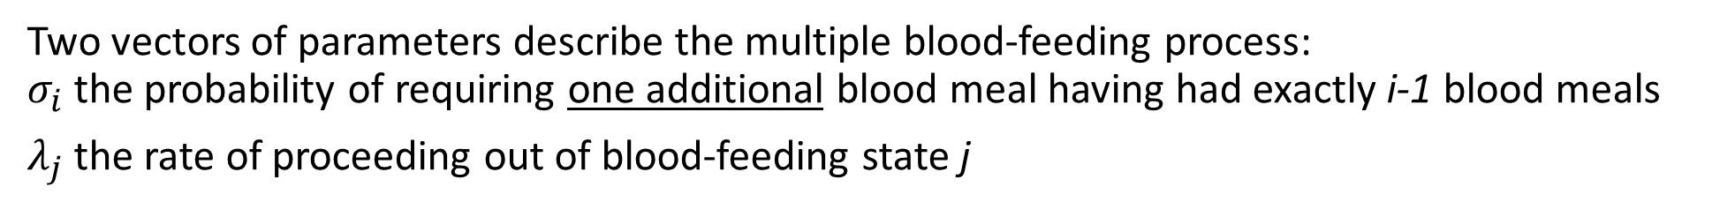




“Disrupt” model
$$σ_{1}λ_{1}$$
$$σ_{2}λ_{2}$$
$$σ_{3}λ_{3}$$
Aquatic stage
Blood-feeding
$$(1−σ_{1})λ_{1}$$
Blood-feeding
$$(1−σ_{2})λ_{2}$$
Blood-feeding
Blood-feeding
$$λ_{k}$$
Ovipositing
Two vectors of parameters describe the multiple blood-feeding process: $σ_{i}$ the probability of requiring one additional blood meal having had exactly i-1 blood meals
$λ_{j}$ the rate of proceeding out of blood-feeding state j

Slide 11







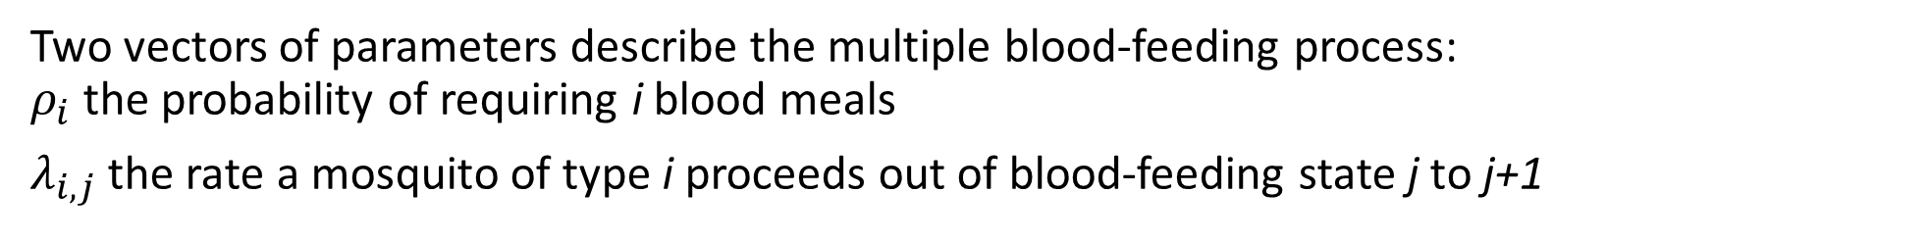






“Fate” model
Blood-feeding
$$λ_{1,1}$$
Oviposition
$$κ_{1}$$
$$λ_{2,1}$$
$$λ_{2,2}$$
Blood-feeding
Blood-feeding
Oviposition
$$κ_{2}$$
$$κ_{3}$$
$$λ_{3,1}$$
$$λ_{3,2}$$
$$λ_{3,3}$$
Aquatic stage
Blood-feeding
Blood-feeding
Blood-feeding
Oviposition
$$κ_{k}$$
$$λ_{k,1}$$
$$λ_{k,2}$$
$$λ_{k,k}$$
Blood-feeding
Blood-feeding
Blood-feeding
Blood-feeding
Oviposition
Two vectors of parameters describe the multiple blood-feeding process: $ρ_{i}$ the probability of requiring i blood meals
$λ_{i,j}$ the rate a mosquito of type i proceeds out of blood-feeding state j to j+1

Slide 12
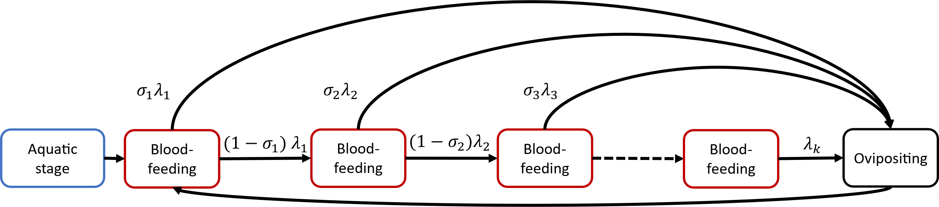
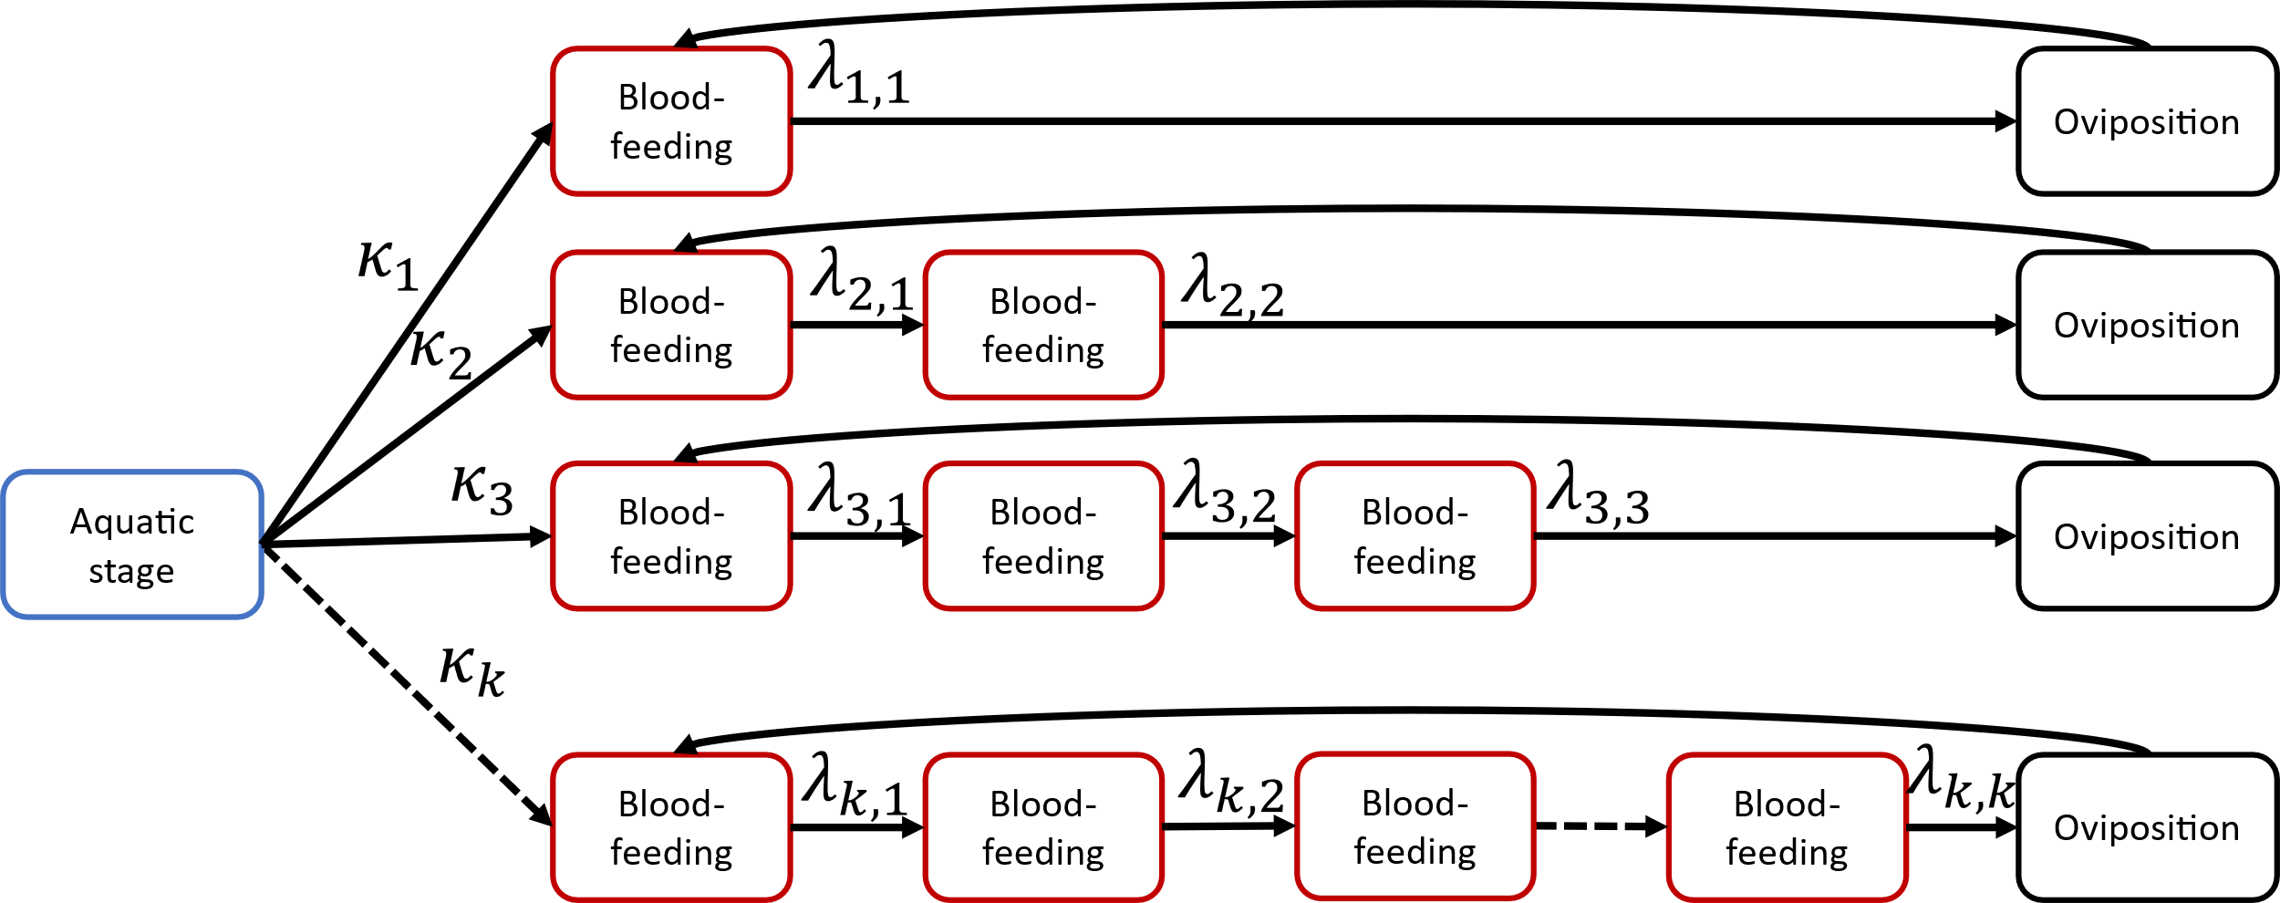
“Disrupt” model
“Fate” model
Notes:
Given a fixed extrinsic incubation period, what fraction of compartments are potentially transmissible.
Assume all mosquitoes acquire infection on their first bite.

Slide 13
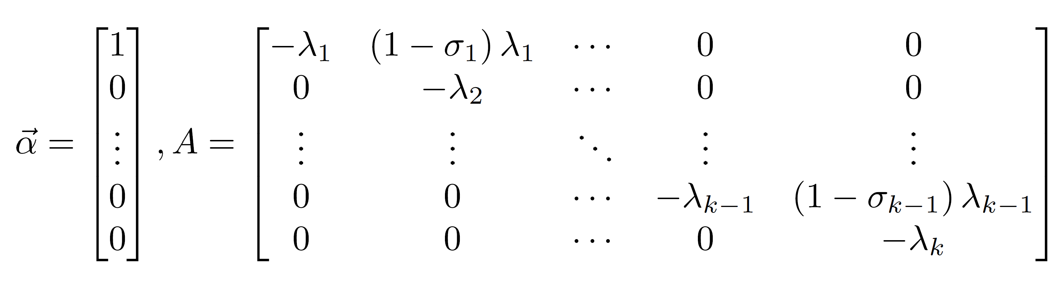
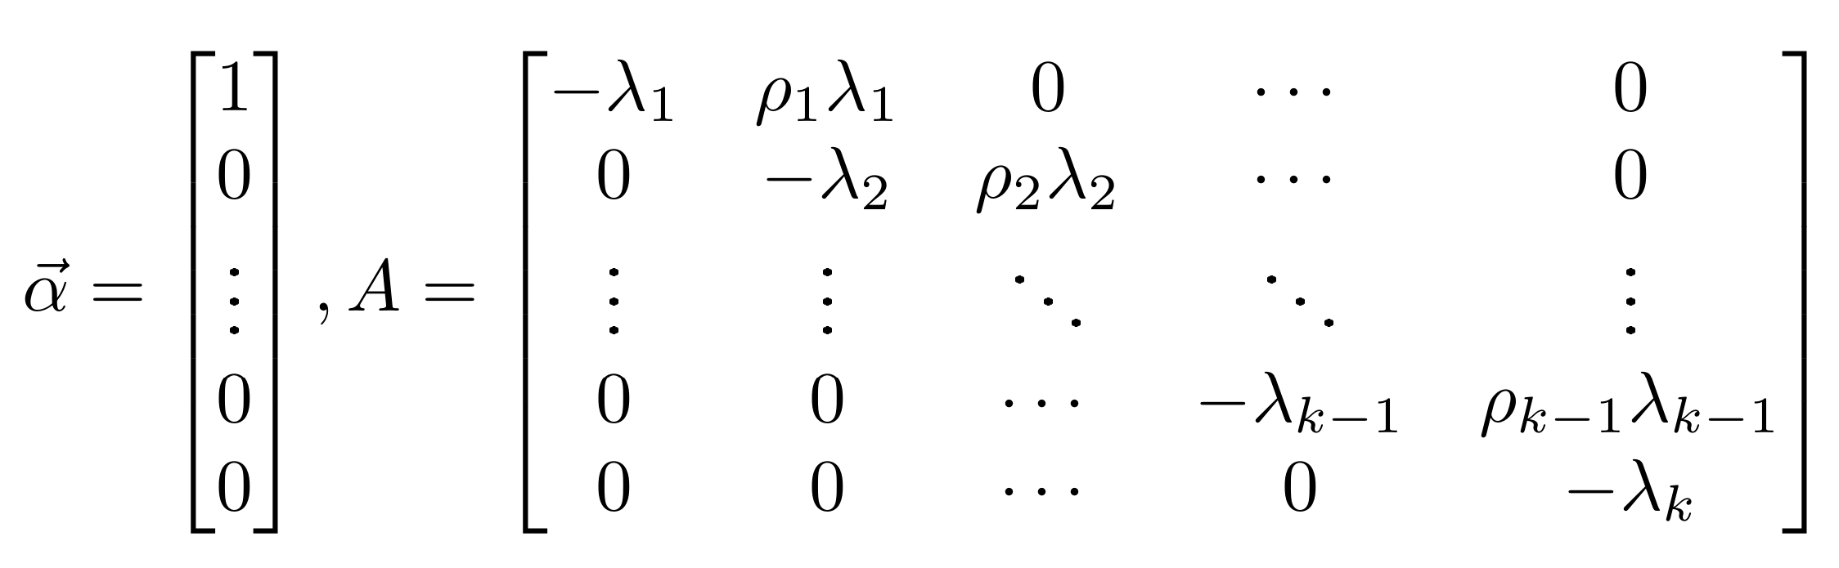
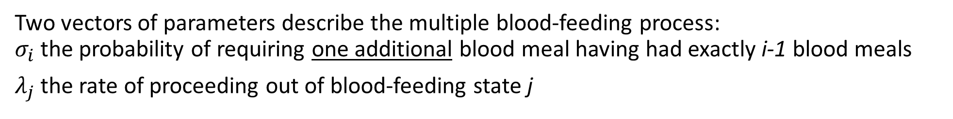
“Disrupt” model, specified
Two vectors of parameters describe the multiple blood-feeding process: $σ_{i}$ the probability of requiring one additional blood meal having had exactly i-1 blood meals
$λ_{j}$ the rate of proceeding out of blood-feeding state j

Slide 14
“Fate” model
Blood-feeding
Oviposition
Blood-feeding
Blood-feeding
Oviposition
Aquatic stage
Blood-feeding
Blood-feeding
Blood-feeding
Oviposition
Blood-feeding
Blood-feeding
Blood-feeding
Blood-feeding
Oviposition
Larval rearing conditions determine the distribution of mosquitoes needing 1, 2,…, k blood meals to attain the repletion state

Slide 15


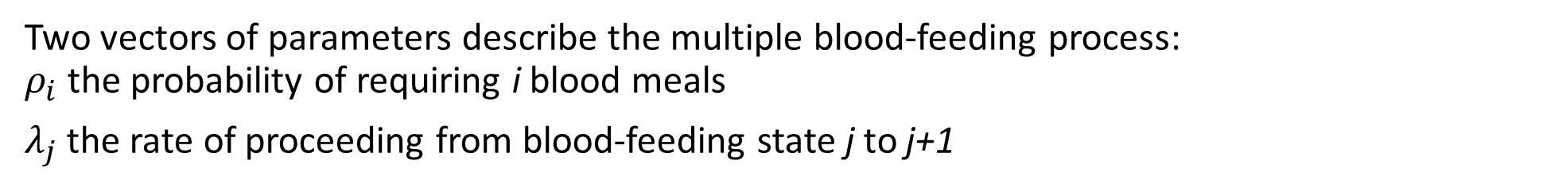


“Fate” model
Blood-feeding
$$λ_{1,1}$$
Oviposition
$$ρ_{1}$$
$$λ_{2,1}$$
$$λ_{2,2}$$
Blood-feeding
Blood-feeding
Oviposition
$$ρ_{2}$$
$$ρ_{3}$$
$$λ_{3,1}$$
$$λ_{3,2}$$
$$λ_{3,3}$$
Aquatic stage
Blood-feeding
Blood-feeding
Blood-feeding
Oviposition
$$ρ_{k}$$
$$λ_{k,1}$$
$$λ_{k,2}$$
$$λ_{k,k}$$
Blood-feeding
Blood-feeding
Blood-feeding
Blood-feeding
Oviposition
Two vectors of parameters describe the multiple blood-feeding process: $ρ_{i}$ the probability of requiring i blood meals
$λ_{j}$ the rate of proceeding from blood-feeding state j to j+1

Slide 16









Alternative “Fate” model: one oviposition compartment
Blood-feeding
$$ρ_{1}$$
$$λ_{1}$$
Blood-feeding
Blood-feeding
$$ρ_{2}$$
$$ρ_{3}$$
$$λ_{1}$$
$$λ_{2}$$
Aquatic stage
Blood-feeding
Blood-feeding
Blood-feeding
Oviposition
$$ρ_{k}$$
Blood-feeding
$$λ_{1}$$
Blood-feeding
$$λ_{2}$$
Blood-feeding
Blood-feeding
The previous model maintains the history of individuals in the form of the number of bites needed to reach repletion.
This formulation better follows the framework of Paul Hurtado’s work, where individuals lose their “identity” upon leaving a series of compartments.

Slide 17
Questions
It’s possible that different species fit better into different models of multiple blood feeding. How can we tell which model fits better?
What is a fair comparison between the two models?
Can we use data to fit the probabilities and rates?
Data only tells us the proportion of mosquitoes collected which have had 1, 2, etc. blood meals in their current gonotrophic cycle
What types of data exist? The available data might predetermine the best model. Data might suggest which model fits better.
With these models, can we independently set average mosquito lifespan and average number of gonotrophic cycle in a single lifespan?
May relate to identifiability: we have too many co-dependent parameters
If we use the same probabilities and rates in both models, how do results from each model differ?
Distribution of biting stages at equilibrium
Reproductive number
Transmission potential

Slide 18
Possible data sources
Field
Capture mosquitoes and estimate the number of blood meals they’ve had
NB: If this doesn’t “reset” after oviposition, the memoryless property of the models is violated
Species-specific assays. Gives a lower bound on # of blood meals based on diversity of prey
Semi-field / residential
Household studies finding DNA sources in mosquito guts
Experimental
Behavior tracking. Measuring time between feedings and number of feedings before oviposition.

Slide 19
Analyses
Compare the conditions for existence and stability of disease-free equilibria
Find stable population distribution among blood-feeding stages and use this to fit multiple blood-feeding parameters to data
Compare the conditions for existence and stability of endemic equilibria
Develop some representative simulations of transient and equilibrium dynamics

Slide 20
Preliminary analysis of the “Disrupt” model
Probability of going from blood-feeding stage 1 to stage i
Total probability of going from blood-feeding stage 1 to oviposition stage
Probability of going to oviposition stage from stage i

Slide 21
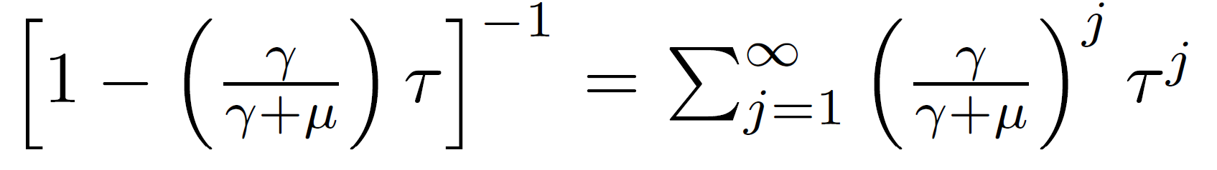
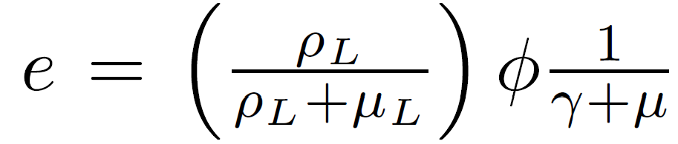

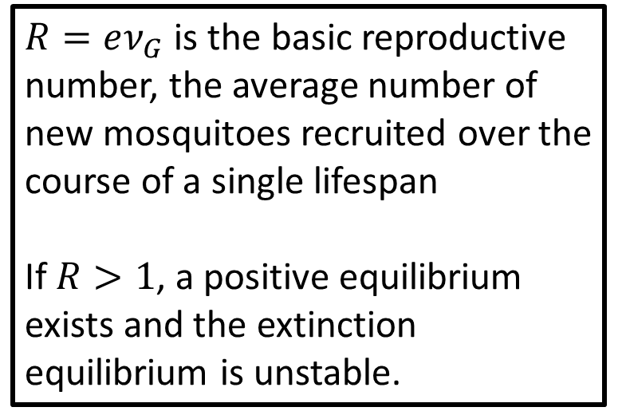
Preliminary analysis of the “Disrupt” model
Probability of surviving all blood-feeding stages
Average number of gonotrophic cycles in a lifespan
$$ν_{G}=$$
Probability of surviving the oviposition stage
$R=eν_{G}$ is the basic reproductive number, the average number of new mosquitoes recruited over the course of a single lifespan
If $R>1$, a positive equilibrium exists and the extinction equilibrium is unstable.
Average number of new mosquitoes recruited by one mosquito in a single gonotrophic cycle
Probability of surviving the aquatic stage
Average number of eggs laid in one gonotrophic cycle

Slide 22
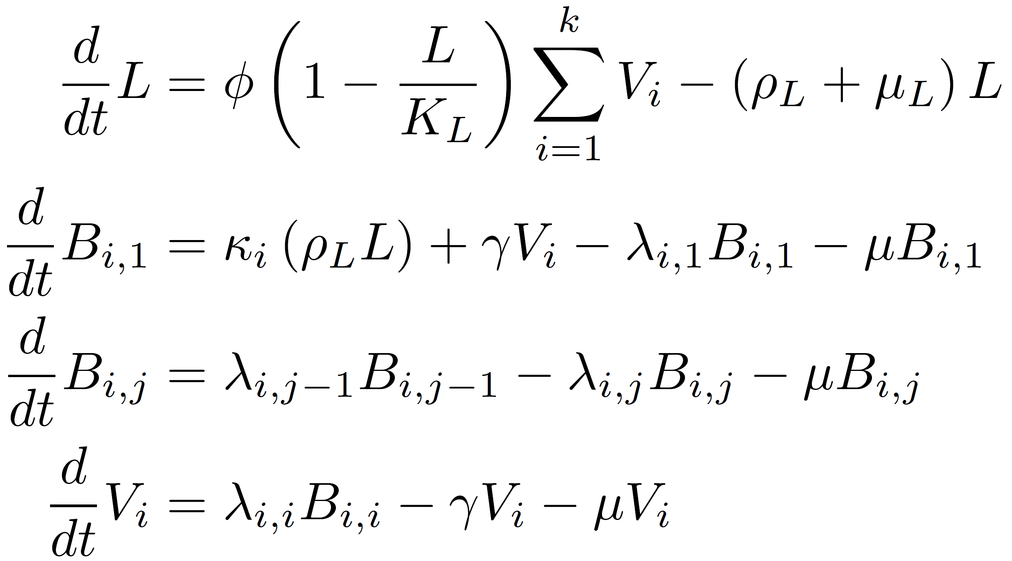
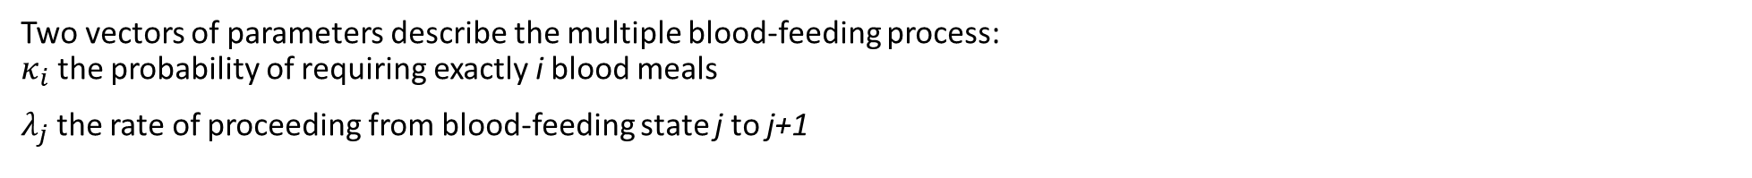

“Fate” model, specified
Larval or aquatic stages
Blood-feeding stages
$$, 1<j≤i≤k$$
Oviposition stages
Cannot be represented using the matrix-vector form described in Hurtado and Kirosingh (2019) because of the additional index on the blood-feeding stages
Two vectors of parameters describe the multiple blood-feeding process: $κ_{i}$ the probability of requiring exactly i blood meals
$λ_{j}$ the rate of proceeding from blood-feeding state j to j+1

Slide 23
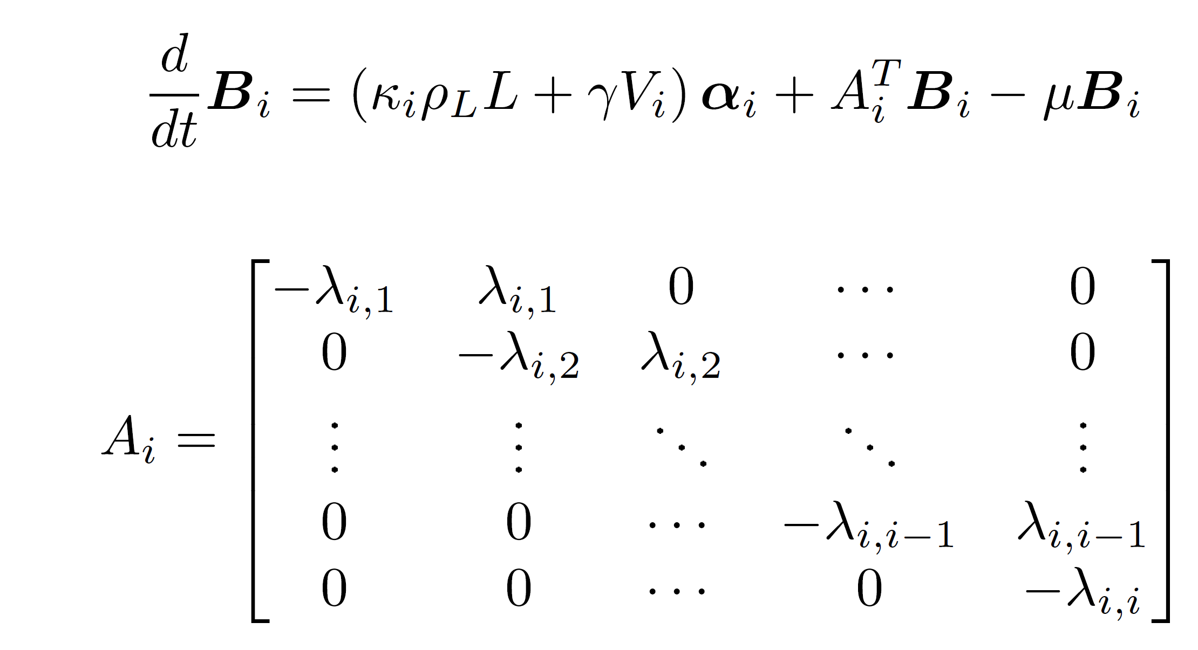

“Fate” model, specified
Blood-feeding stages
$$, 1≤i≤k$$

Slide 24
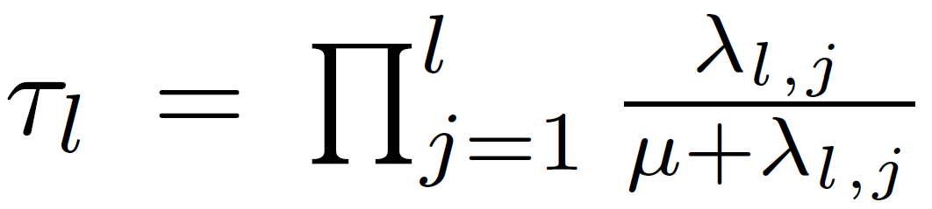
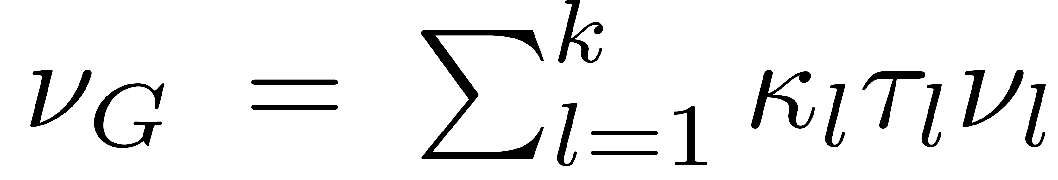
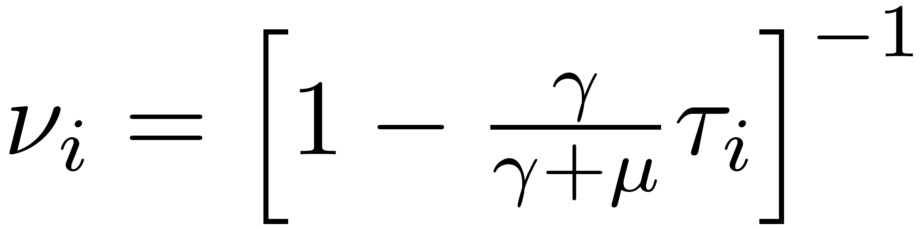
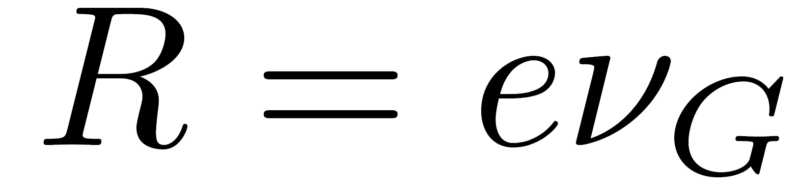
“Fate” model analysis
Probability of a newly-emerged mosquito of type l surviving to the oviposition stage
Weighted average of number of gonotrophic cycles survived by a newly-emerged mosquito
Average number of gonotrophic cycles in a lifespan for a mosquito of type i
Average number of new mosquitoes recruited by one mosquito in a single gonotrophic cycle
Probability of surviving the aquatic stage
Average number of eggs laid in one gonotrophic cycle

Slide 25
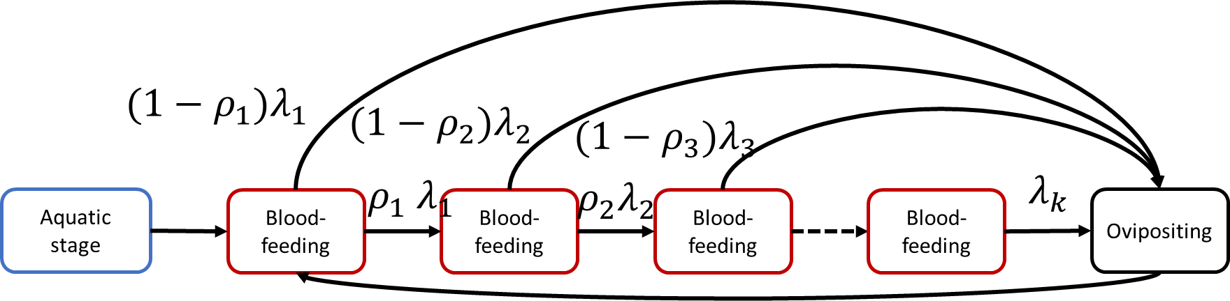
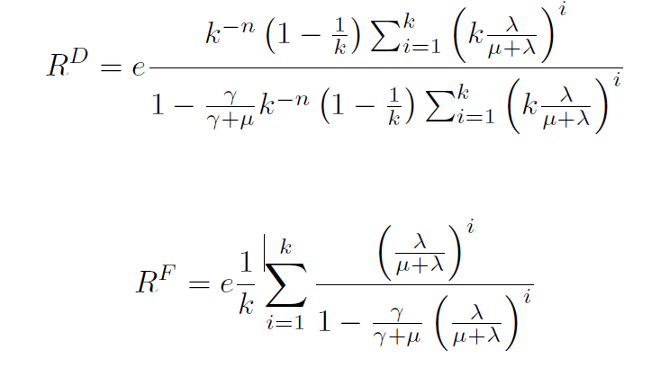
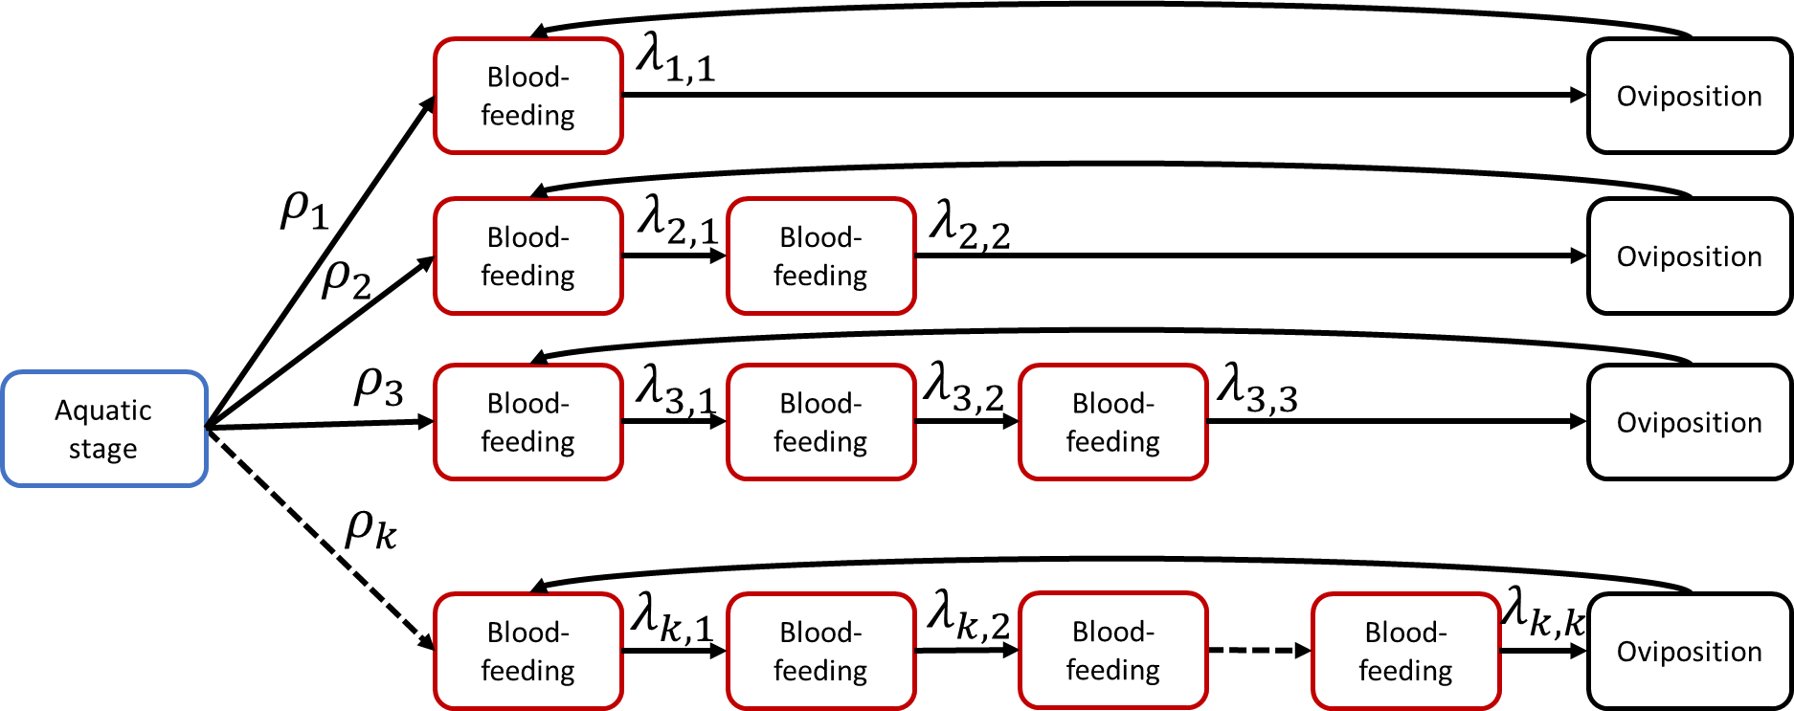
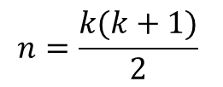
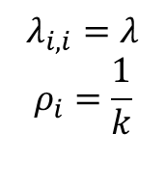
$$λ_{i,i}=λ$$
$$ρ_{i}=\frac{1}{k}$$
Fix “1-rho” and “rho” meaning the “same” thing in the two models
Rhos below need to sum to 1 but rhos above do not. They really have different interpretations
$$n=\frac{k(k+1)}{2}$$
Notes:
Given a fixed extrinsic incubation period, what fraction of compartments are potentially transmissible.
Assume all mosquitoes acquire infection on their first bite.

Slide 26
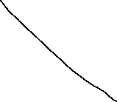
All lambdas equal
Biting rate is independent of mosquito life history
All lambdas equal
Proportions of mosquitoes taking i bites case 1:
Equal numbers from 1 to k
Proportions of mosquitoes taking i bites case 2:
It’s increasingly unlikely that a mosquito needs/takes i bites
Set the time to reach oviposition equal (no matter the cycle length)
(lambda_i,j=lambda_i)
Try a couple values
There’s a resource limitation driving the need to reach oviposition
Time to reach oviposition equal (no matter the cycle length)
Proportions of mosquitoes taking i bites case 2:
Proportions of mosquitoes taking i bites case 1:
Equal numbers from 1 to k

Slide 27
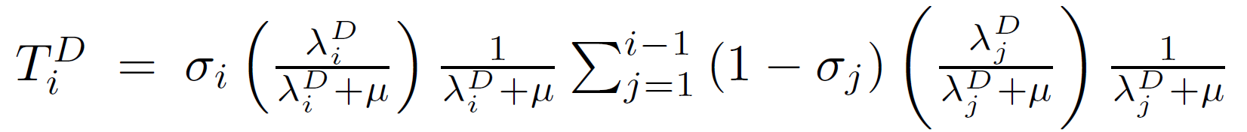
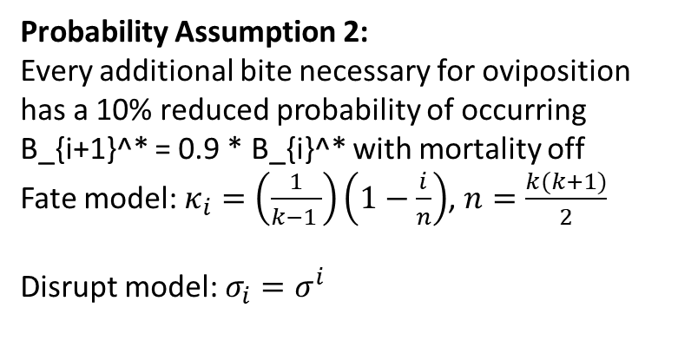
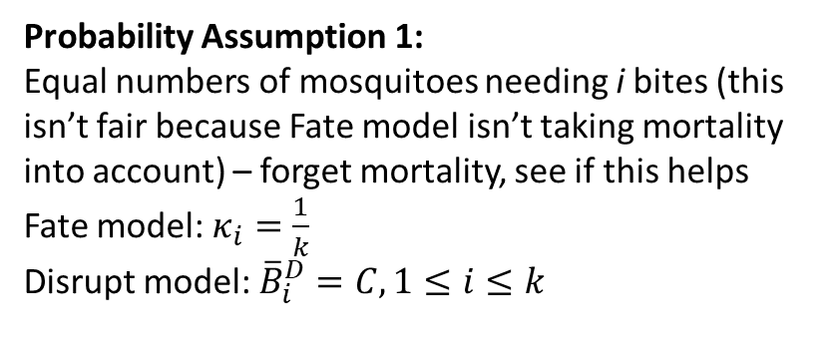
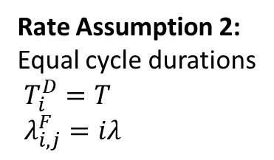
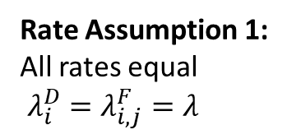
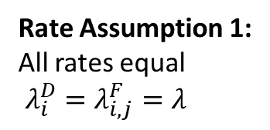
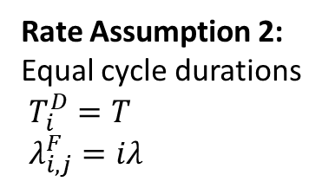
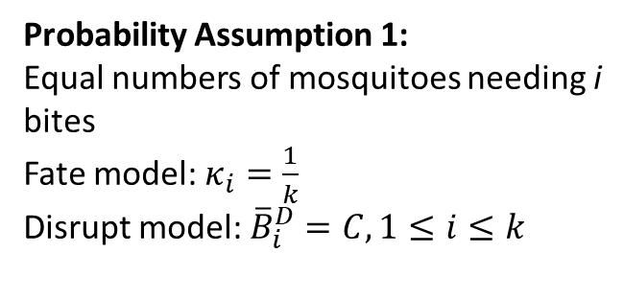
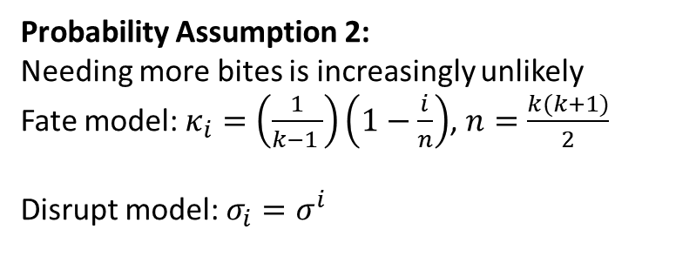
Rate Assumption 1:
All rates equal
$λ_{i}^{D}=λ_{i,j}^{F}=λ$
Rate Assumption 1:
All rates equal
$λ_{i}^{D}=λ_{i,j}^{F}=λ$
Probability Assumption 1:
Equal numbers of mosquitoes needing i bites (this isn’t fair because Fate model isn’t taking mortality into account) – forget mortality, see if this helps
Fate model: $κ_{i}=\frac{1}{k}$
Disrupt model: ${\overline{B}}_{i}^{D}=C,1≤i≤k$
Probability Assumption 2:
Every additional bite necessary for oviposition has a 10% reduced probability of occurring
B_{i+1}^* = 0.9 * B_{i}^* with mortality off
Fate model: $κ_{i}=\left(\frac{1}{k−1 }\right)\left(1−\frac{i}{n}\right)$, $n=\frac{k(k+1)}{2}$
Disrupt model: $σ_{i}=σ^{i}$
Rate Assumption 2:
Equal cycle durations
$T_{i}^{D}=T$
$λ_{i,j}^{F}=iλ$
Rate Assumption 2:
Equal cycle durations
$T_{i}^{D}=T$
$λ_{i,j}^{F}=iλ$
Probability Assumption 2:
Needing more bites is increasingly unlikely
Fate model: $κ_{i}=\left(\frac{1}{k−1 }\right)\left(1−\frac{i}{n}\right)$, $n=\frac{k(k+1)}{2}$
Disrupt model: $σ_{i}=σ^{i}$
Probability Assumption 1:
Equal numbers of mosquitoes needing i bites
Fate model: $κ_{i}=\frac{1}{k}$
Disrupt model: ${\overline{B}}_{i}^{D}=C,1≤i≤k$

Slide 28
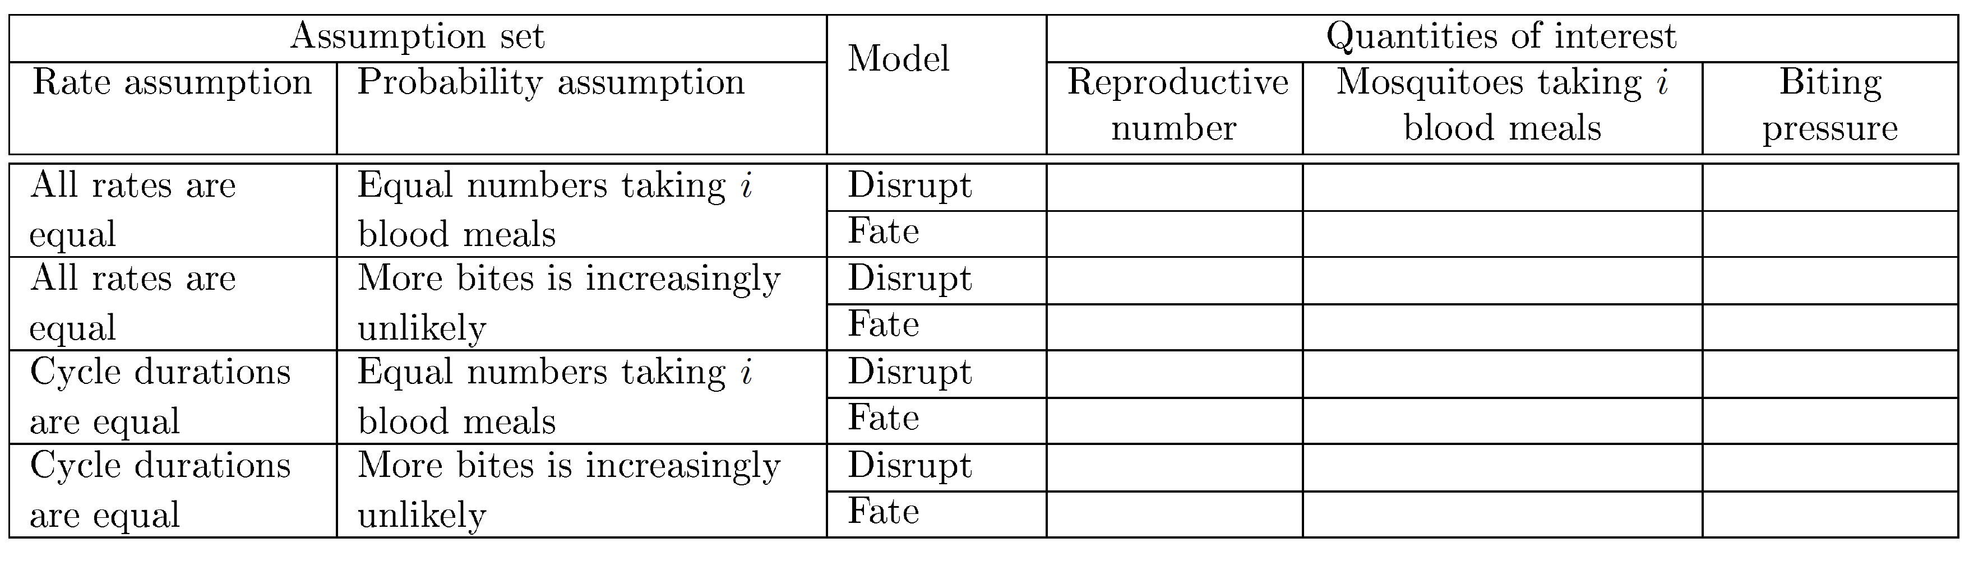
4 x 2 x 3 = 24 combinations
Vary k from 1 to 10
We obtain curves showing how the quantities vary with k
Consider varying mortality
A temporal measure: fraction of mosquitoes that have had one more than one contact within a fixed time window (kind of like a fake EIP)
Figures:
Figure 1: Reproductive numbers vs. k
Linetype = model, color = assumption set
Figure 2: “i“ mosquitoes vs. k
Linetype = model, color = assumption set
Figure 3: Biting pressure vs. k
Linetype = model, color = assumption set
These figures should illustrate whether the two models produce similar ecological/epidemiological results when we parameterize them similarly.
In essence, we’re determining how sensitive the quantities are to the underlying assumptions for the multiple blood-feeding process.

Slide 29
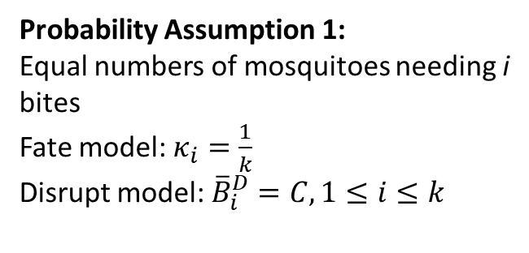

Rate Assumption 1:
All rates equal
$λ_{i}^{D}=λ_{i,j}^{F}=λ$
Rate Assumption 1:
All rates equal
$λ_{i}^{D}=λ_{i,j}^{F}=λ$
Probability Assumption 1:
Equal numbers of mosquitoes needing i bites
Fate model: $κ_{i}=\frac{1}{k}$
Disrupt model: ${\overline{B}}_{i}^{D}=C,1≤i≤k$
If the rates are all equal,
Then population sizes in the compartments must necessarily decrease as you move from left to right
Probability Assumption 2:
Needing more bites is increasingly unlikely
Fate model: $κ_{i}=\left(\frac{1}{k−1 }\right)\left(1−\frac{i}{n}\right)$, $n=\frac{k(k+1)}{2}$
Disrupt model: $σ_{i}=σ^{i}$
Rate Assumption 2:
Equal cycle durations
$T_{i}^{D}=T$
$λ_{i,j}^{F}=iλ$
Rate Assumption 2:
Equal cycle durations
$T_{i}^{D}=T$
$λ_{i,j}^{F}=iλ$
This case is impossible
Probability Assumption 2:
Needing more bites is increasingly unlikely
Fate model: $κ_{i}=\left(\frac{1}{k−1 }\right)\left(1−\frac{i}{n}\right)$, $n=\frac{k(k+1)}{2}$
Disrupt model: $σ_{i}=σ^{i}$
Probability Assumption 1:
Equal numbers of mosquitoes needing i bites
Fate model: $κ_{i}=\frac{1}{k}$
Disrupt model: ${\overline{B}}_{i}^{D}=C,1≤i≤k$

Slide 30
To proceed, need to translate the rate and probability assumptions into parameterizations of the two models. This process is not necessarily straightforward.
After this, I’ll program the equations for each of the QoI x Assumption x Model combinations and calculate them across the range of k values we’re interested in.
Finally, I’ll plot the three figures described in the previous page.

Slide 31
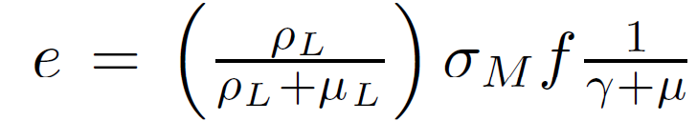
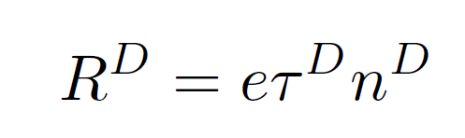
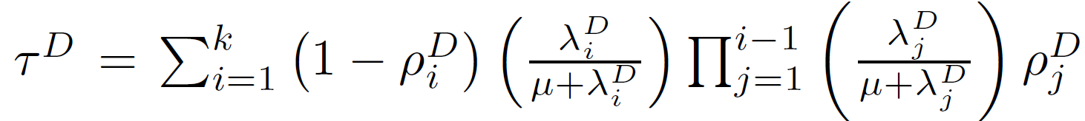
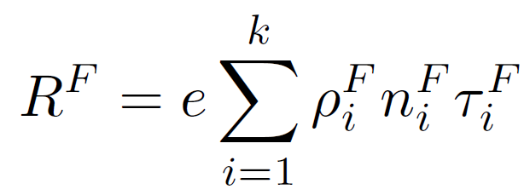
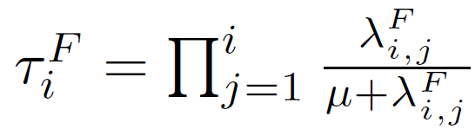
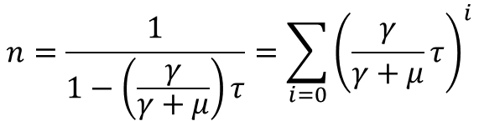
Reproductive numbers
Viable eggs per female per oviposition cycle:
Total probability of surviving to reach oviposition stage:
$$n=\frac{1}{1−\left(\frac{γ}{γ+μ}\right)τ}=\sum_{i=0}{{\left(\frac{γ}{γ+μ}τ\right)}^{i}}$$
Total probability of surviving to reach oviposition stage for mosquitoes of type i:

Slide 32
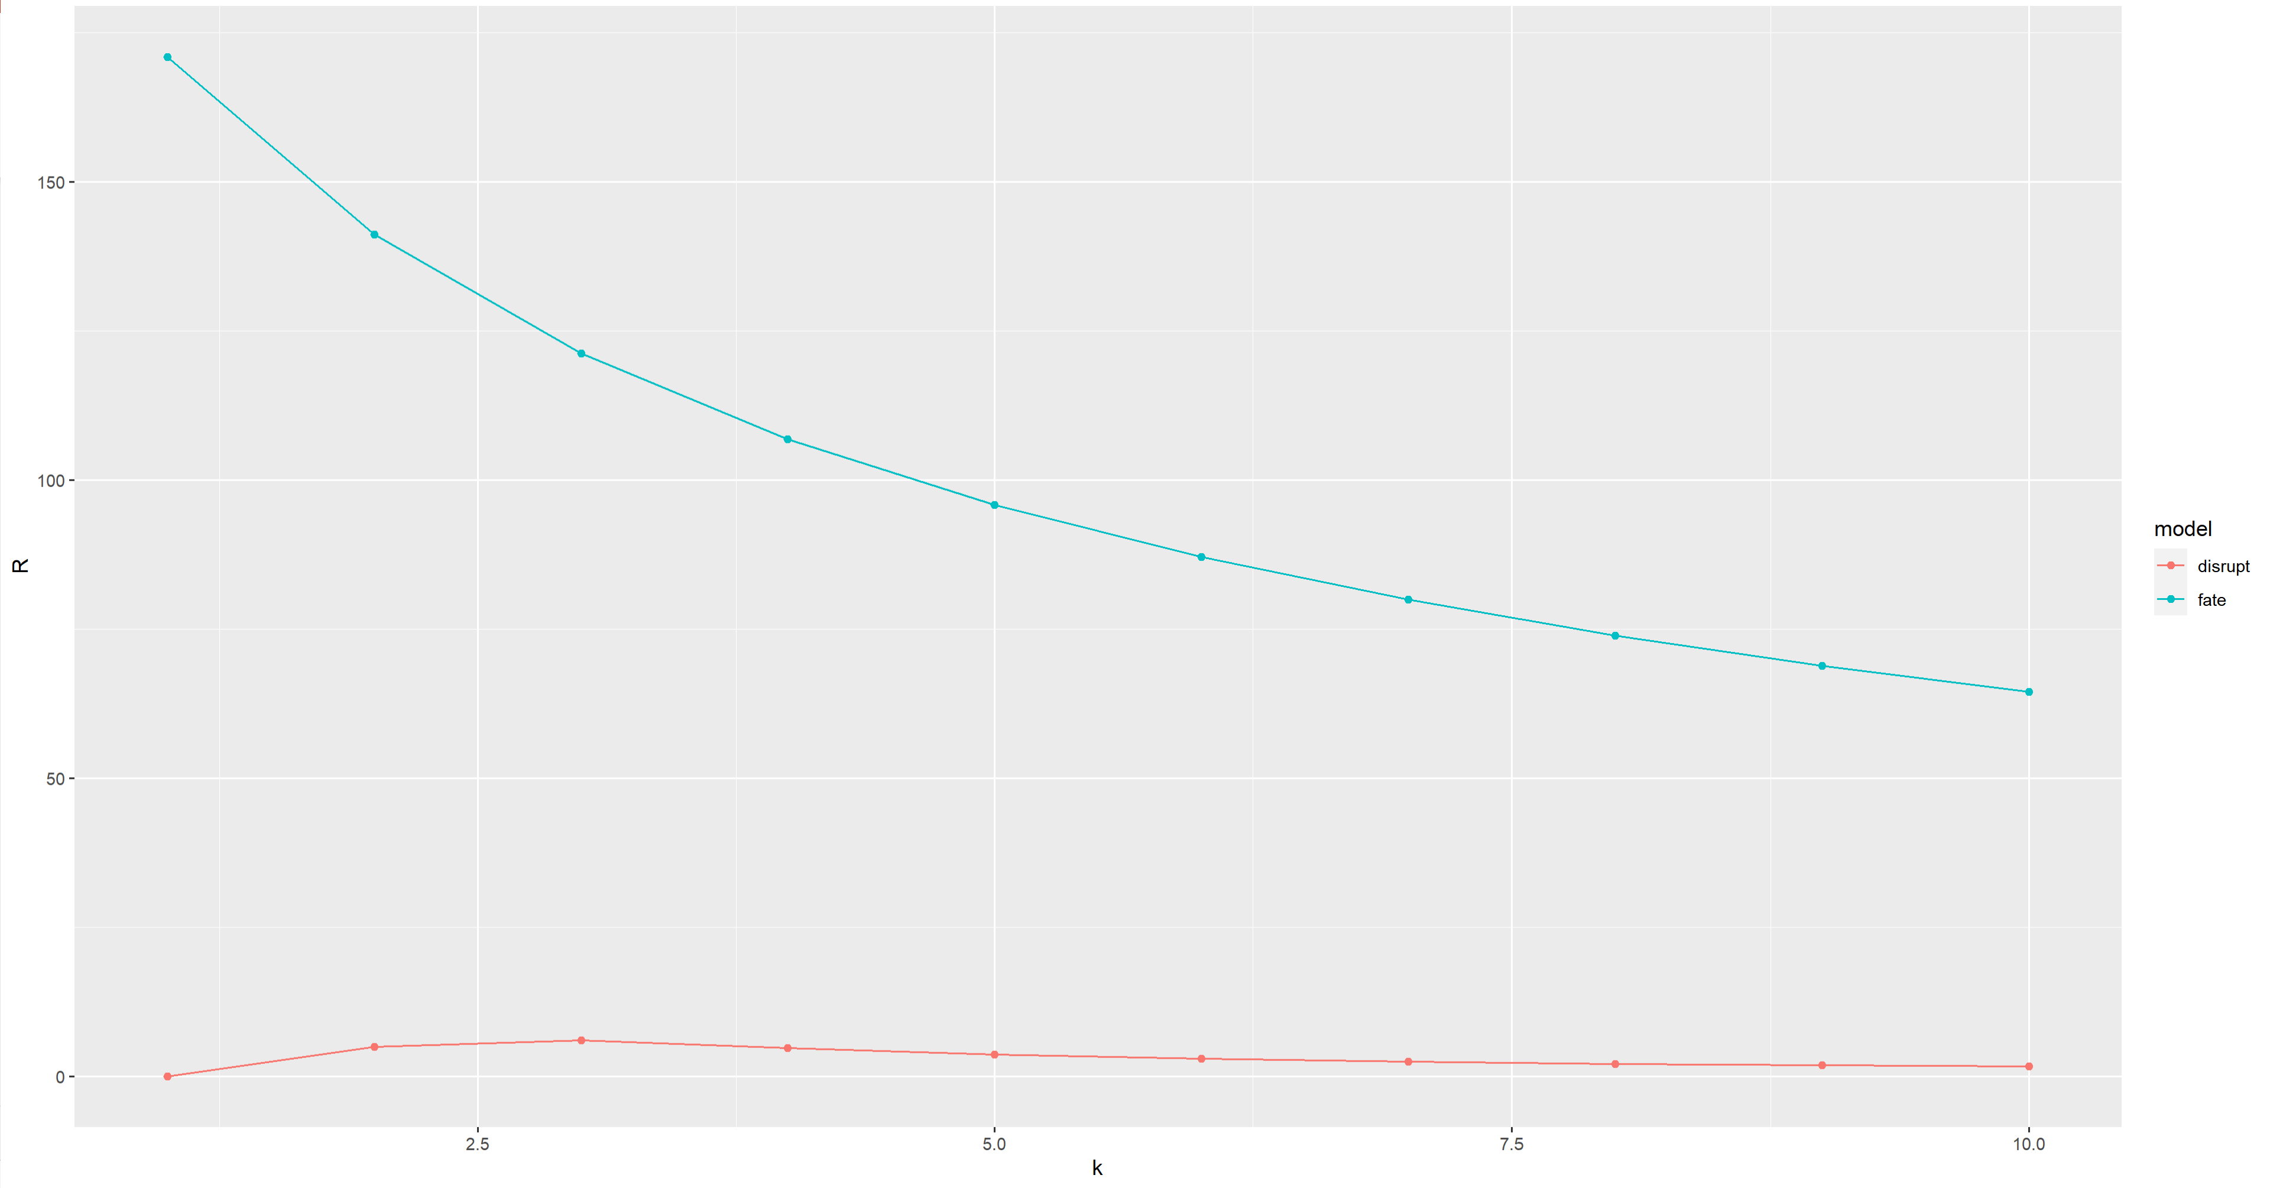

Simple case: All $λ$’s = $λ$, all $ρ$’s =1/k
All $ρ$’s = $\frac{1}{k}$

Slide 35
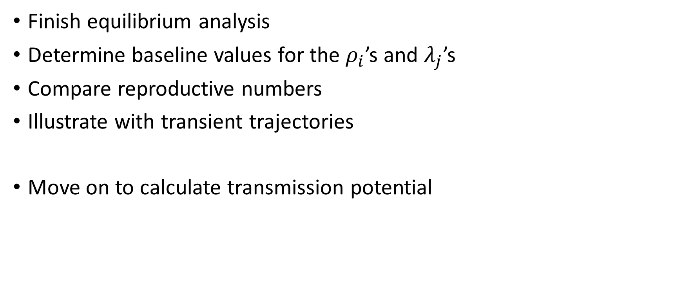
Next steps
Finish equilibrium analysis
Determine baseline values for the $ρ_{i}$’s and $λ_{j}$’s
Compare reproductive numbers
Illustrate with transient trajectories
Move on to calculate transmission potential

